Slide 1
BIA 679
Project Abstract
Data scientist Entrance and Future Salary Expectation
Mentor Professor:
Fengpei Gao
Hong Huang
Zhaoyi Xu
Sep28， 2022

Slide 2



Fengpei Gao
Hong Huang
Zhaoyi Xu

Slide 3
Business Question
Data scientist is a well-known job all over the world in the modern big-data world
The goal of our group project is to use the data
to make a prediction about the salary of data scientists.
And make career forecasts for data scientists by using datasets.

Slide 4
Data Source
The data sources we used for our group project come from Kaggle
There are two main datasets we use to fulfill our analytical purpose.
The first dataset is about the salary of data scientists
https://www.kaggle.com/datasets/ruchi798/data-science-job-salaries/metadata
The second dataset is about the job change of data scientists
https://www.kaggle.com/code/jackcook/how-to-become-a-data-scientist/data?select=freeformResponses.csv
https://www.kaggle.com/code/hiteshp/head-start-for-data-scientisthttps://www.kaggle.com/code/hiteshp/head-start-for-data-scientist

Slide 5
Method of solving problem
Job Entrance
Job Salary Forecasting
Decision Tree
Random Forest
Linear SVC
Logistic regression:
Gradient-Boosted Tree
Bayesian Approach
Performance Measures
Tools
Precision Score, Recall, F1 score,
Accuracy
AUC score
PySpark on cloud platforms like AWS or databricks
Numpy local
Dashboard online if time allowed
Notes:
https://www.payscale.com/research/US/Job=Forecast_Analyst/Salary/5027beec/Data-Modelinghttps://www.payscale.com/research/US/Job=Forecast_Analyst/Salary/5027beec/Data-Modeling
https://www.payscale.com/research/US/Job=Forecast_Analyst/Salary/5027beec/Data-Modeling

Slide 6
Project Scope
7 weeks/milestones to get the mission accomplished
105 working hours in total
15 total working hours per week/milestone
5 working hours per week/milestone per team member
Code Sharing:
GitHub (https://github.com/kaylaxzy/Big-Data-Practicum)
Project Management:
Jira (https://kaylaxu.atlassian.net/jira/software/projects/T2/boards/1/roadmap )

Slide 7
Weekly Project Plan
- Overview
Week 1 - getting raw data source for salaries
Week 2 - compare data sources that we get
Week 3 - get the online flatform ready for use
Week 4 - start to check on and apply different models
Week 5 - add performance measures
Week 6 - compare model performance
Week 7 - conclusion and visualization

Slide 8
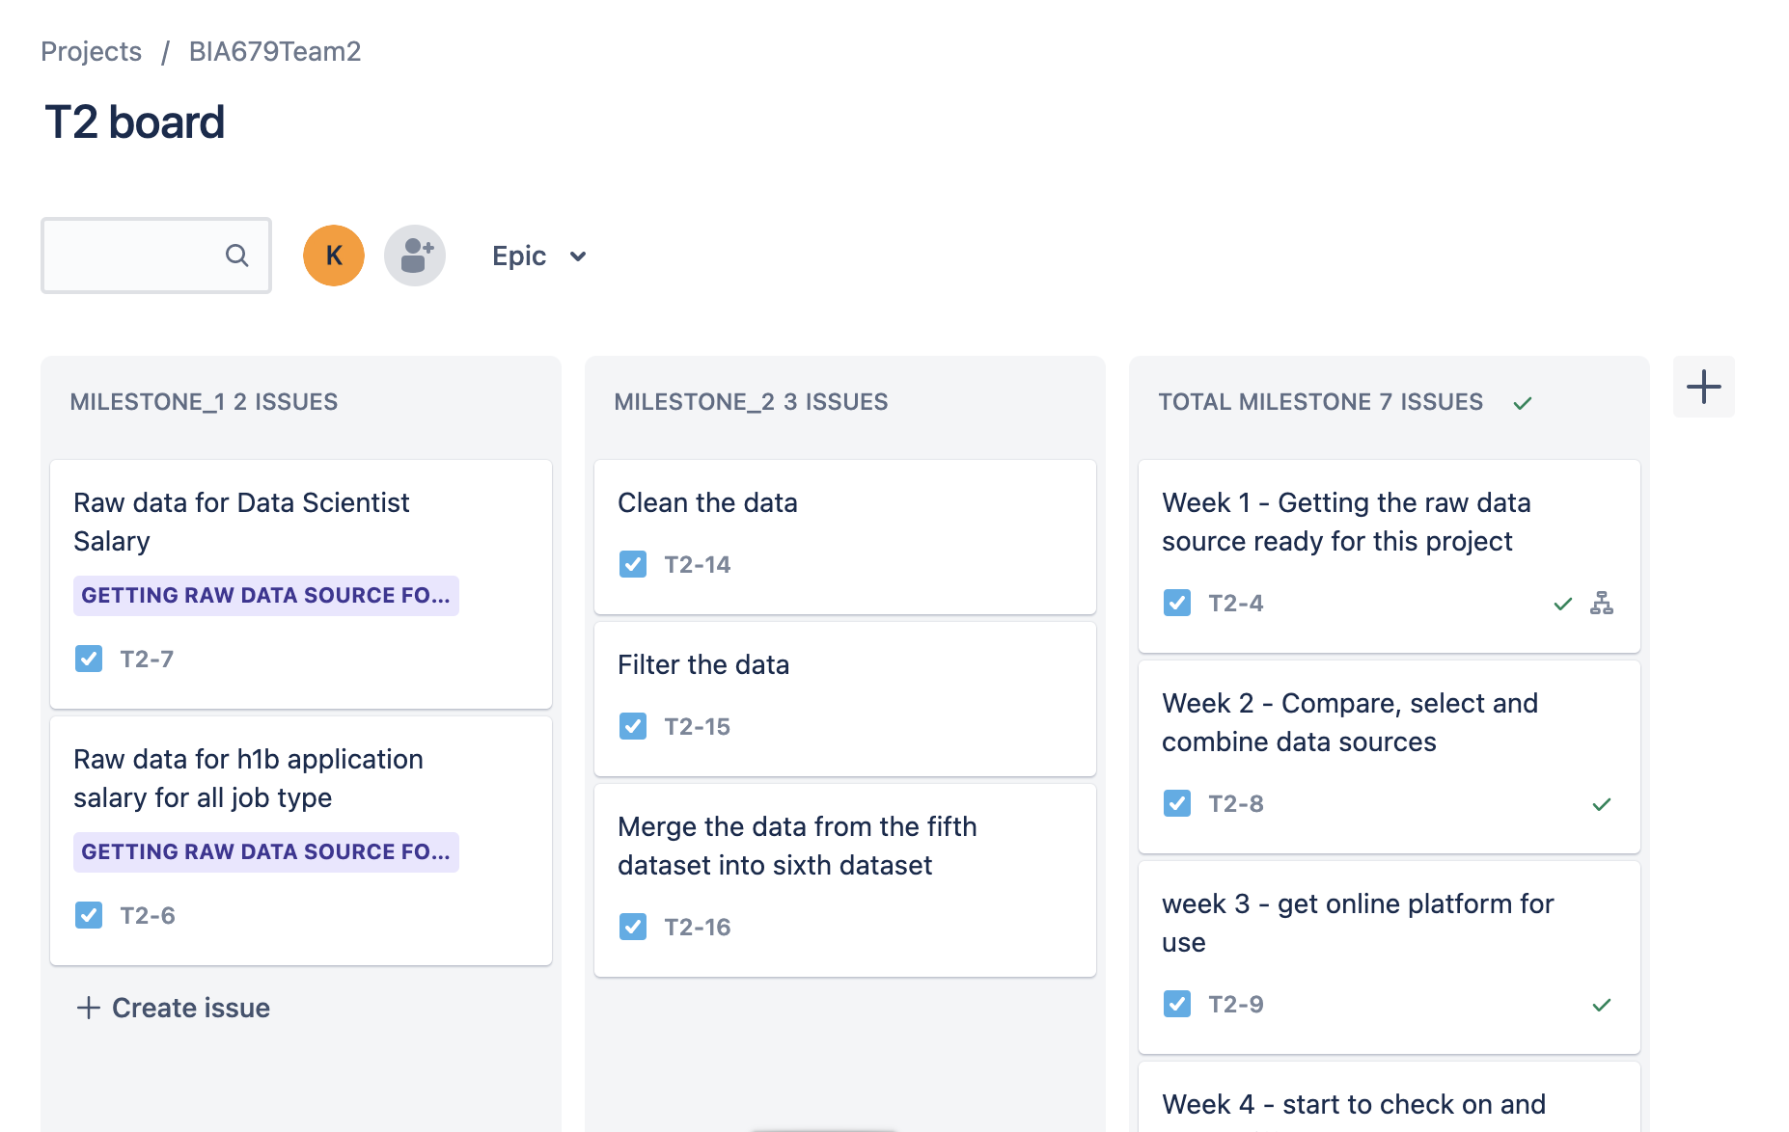
Milestone 1

Slide 9
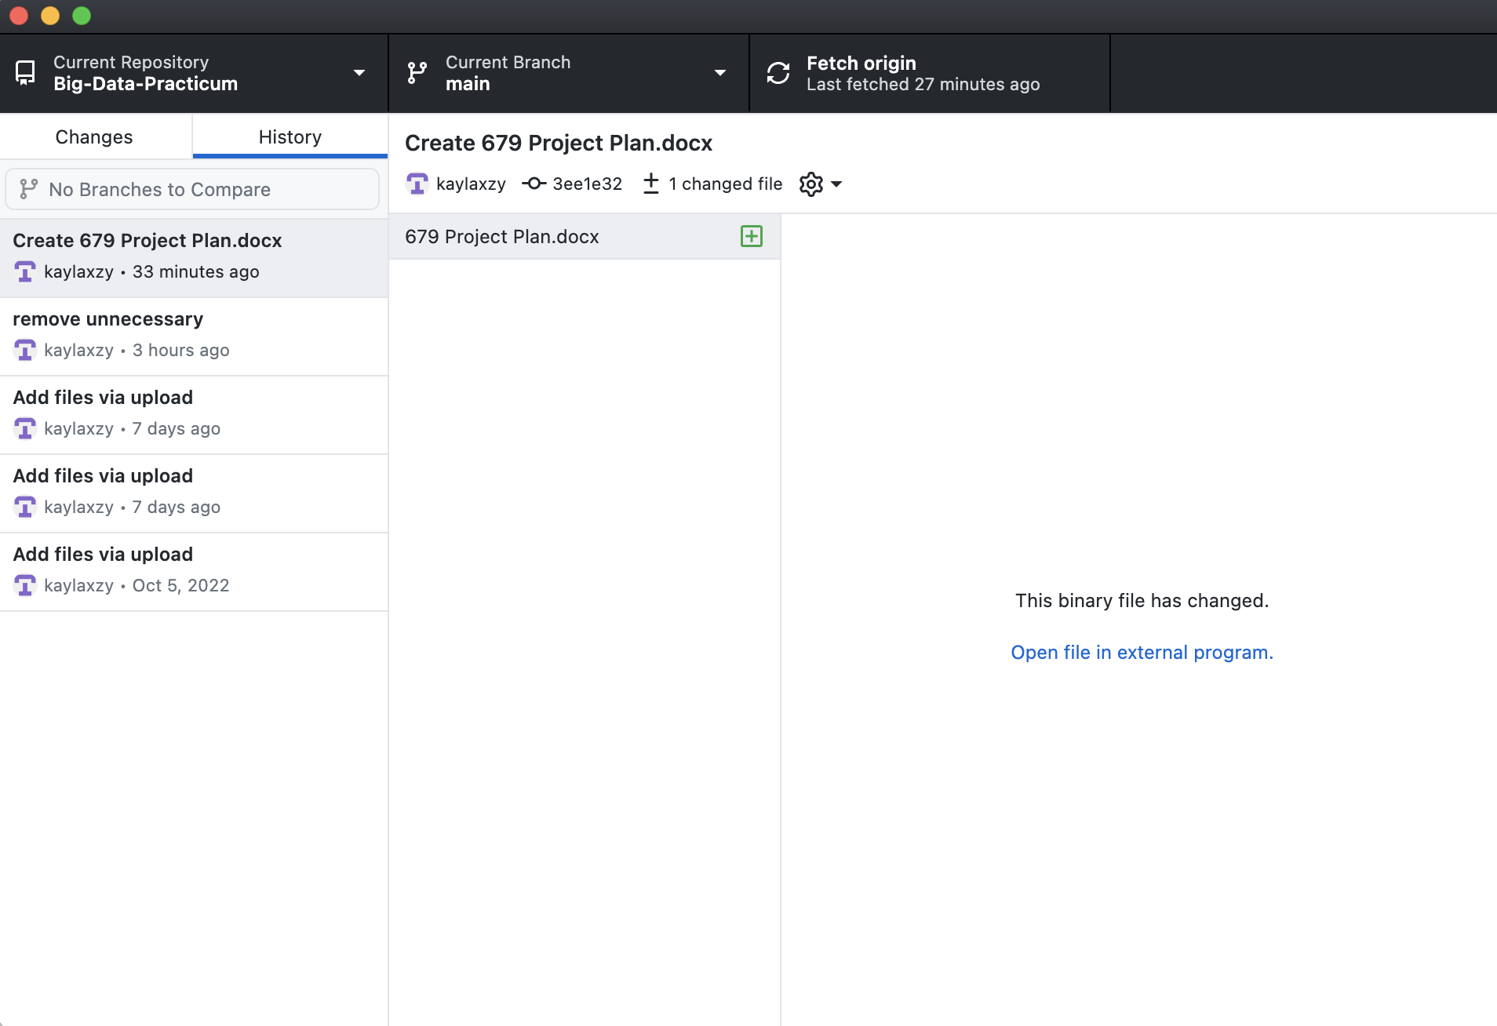
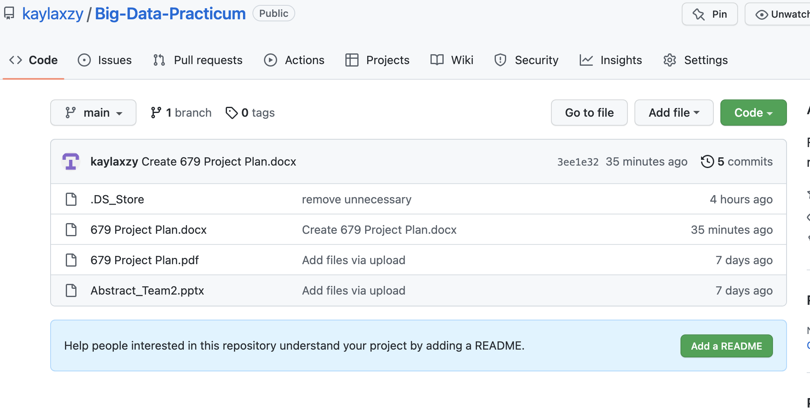
GitHub

Slide 10
Raw Data
10000 data scientists jobs posting from the USA
https://www.kaggle.com/datasets/jobspikr/data-scientist-job-postings-from-the-usa
50.91 MB
22 columns
(Job title, city, company name, job type, salary offered and etc.)
10000 rows (need data cleaning)
H-1B Visa Petitions 2011-2016
https://www.kaggle.com/datasets/nsharan/h-1b-visa
492.26 MB
11 columns
(case status, job title, wage, work site, ion, lat and etc.)
> 3 M rows

Slide 11
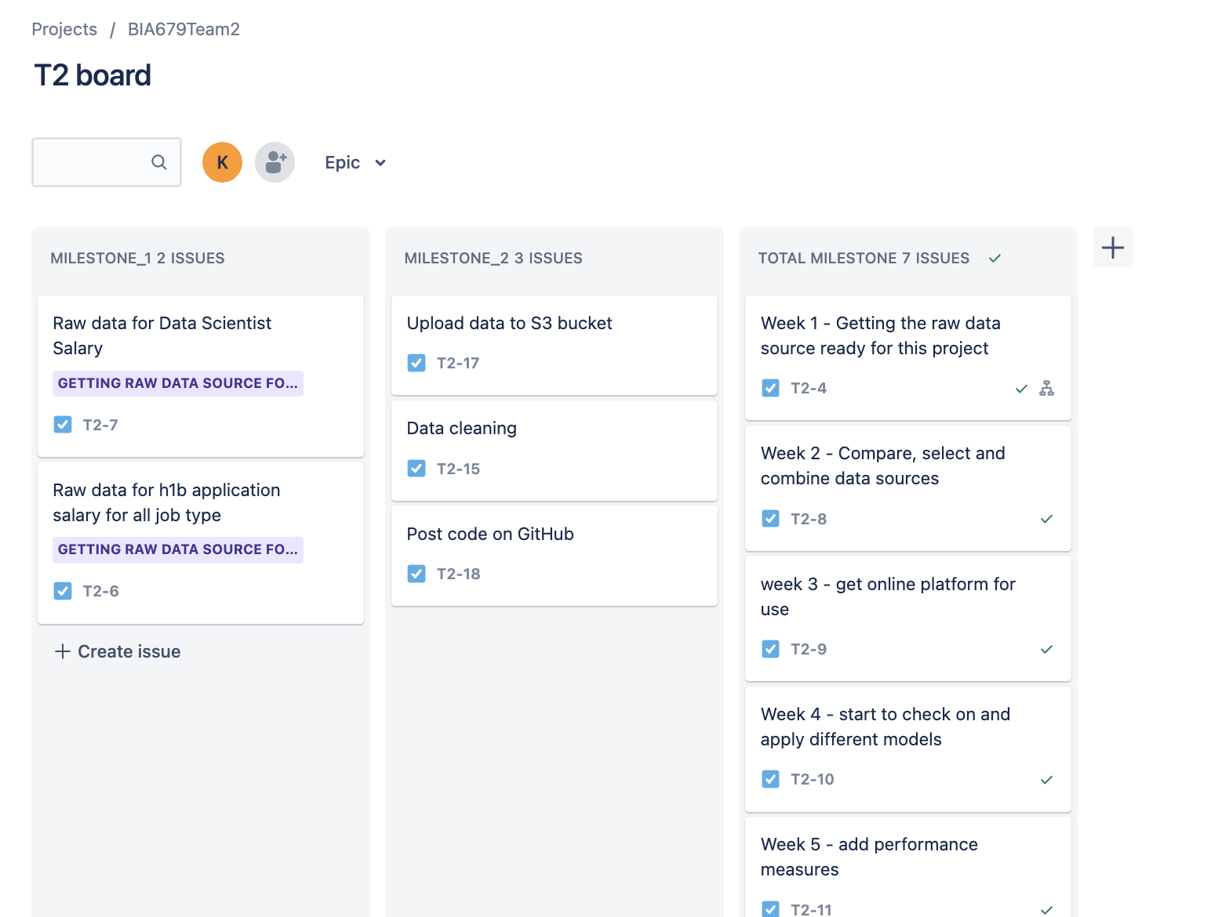
Milestone 2

Slide 12
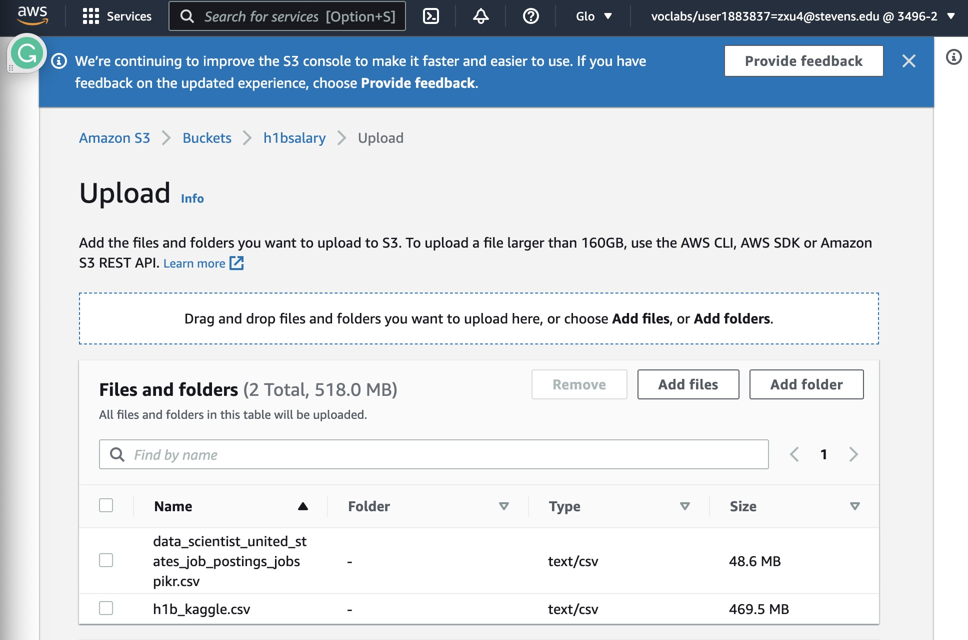
AWS S3

Slide 13
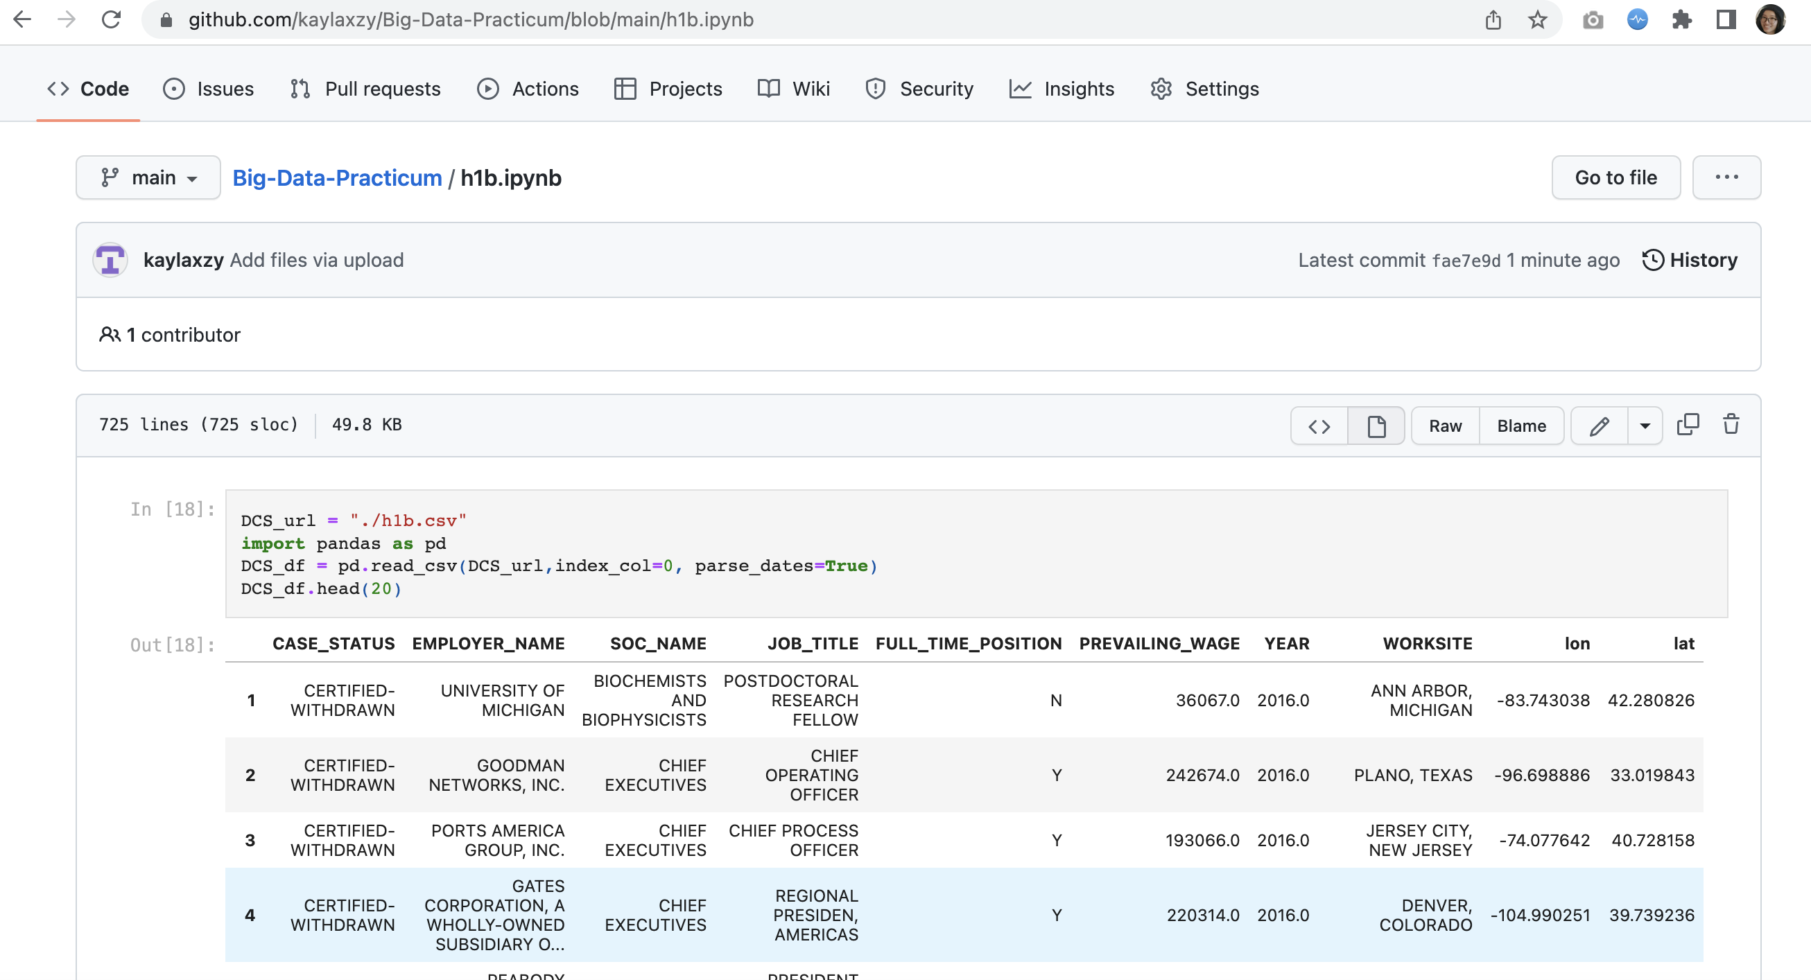
GitHub Codes
https://github.com/kaylaxzy/Big-Data-Practicum/blob/main/h1b.ipynb

Slide 14

https://books.google.com/books?hl=en&lr=&id=uAPuDwAAQBAJ&oi=fnd&pg=PP1&dq=data+cleaning+techniques+python&ots=Cl6Kub9StV&sig=5jyNg451S4e3G_1FsaWpiwQvUV0#v=onepage&q=data%20cleaning%20techniques%20python&f=false

Slide 15
Data Model Exploration
1):H1B Exploratory analysis(EDA):
https://www.kaggle.com/code/sharathkrishnan86/h1b-exploratory-analysis
2):H-1B Visa Prediction using Machine Learning(Logistic Regression Model):
https://www.kaggle.com/code/akhilkasare/h-1b-visa-prediction-using-machine-learning

